Slide 1




Artificial Intelligence
AVA
AI VISION ASSISTANT
PRESENTATION

Slide 2
Project Supervisor : Dr.Nermine Elkashef
Name | ID
Ahmed Taha Mohamed Mohamed | 22010315
Abdullah Jamal Al-Sayed Khalil | 22010366
Fouad Ramzy Fouad Hassan | 22010180
Mostafa Mahmoud Mohamed Noseir | 22010260
Youssef Mohamed Abdelkader | 22010311
Graduation Project I Documentation - Academic Year (2025 – 2026)

Slide 3
Agenda
Introduction & Project Overview
Overview
Problem Statement
Importance, Goals & Features Comparison
Businiess Requirements
Gathering Methods & Results
Functional & Non-functional Requirements
System Design
Use Case Diagram
Sequence, Block, Data Flow, State Diagrams
ERD & UML Class Diagram
Implementation Aspects
Datasets
Tools & Technologies
Prototype Screenshots
Future Work Plan
Remaining Tasks
Risks & Solutions
Conclusion & Q&A

Slide 4
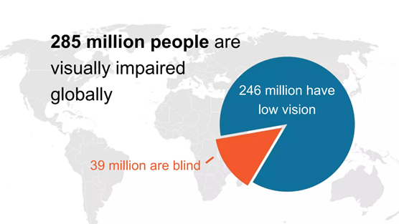
OVERVIEW
Global Issue:
~39 million people are blind worldwide
~285 million have moderate-to-severe visual impairment
at least 2.2 billion people have a near or distance vision impairment - WHO

Slide 5
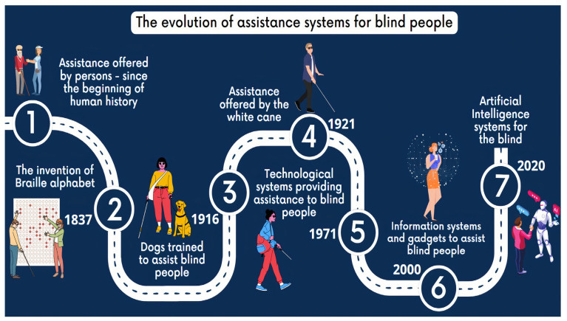

Slide 6
PROBLEM STATEMENT
Visually impaired individuals face serious daily challenges:
Identifying nearby objects and obstacles
Recognizing familiar people
Understanding Surroundings (Indoor & Outdoor)
Distinguishing currency denominations
Reading printed text (medicine, bills, signs)
Identifying colors (clothes, food, surroundings)
Existing assistive apps have major limitations:
Heavy dependence on internet connectivity
Limited support for local environments and currencies
Fragmented features (users need multiple apps)
Privacy and latency issues (cloud processing)
Lack of personalization
Limited Languagages Support

Slide 7

PROJECT IMPORTANCE
Social Impact
Technological Impact
Empowers independence
Reduces reliance on others
Especially vital in Egypt (limited Internet & public support)
Improves safety, confidence, and quality of life
Shows offline AI on mobile is feasible
Focuses on privacy and real-time response
Addresses local needs (Arabic + EGP)

Slide 8
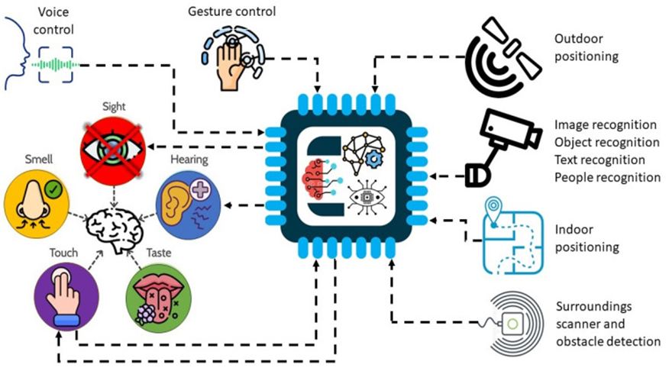
PROJECT GOALS
Develop a fully offline mobile assistant using phone camera + voice feedback
Detect and describe surrounding objects in real time
Recognize familiar people using user-added face photos
Identify Egyptian currency denominations
Read printed text aloud (offline OCR)
Detect dominant colors for daily tasks
Provide voice-based interaction only (hold-to-speak)
Ensure fast, secure, and efficient operation on mobile devices

Slide 9
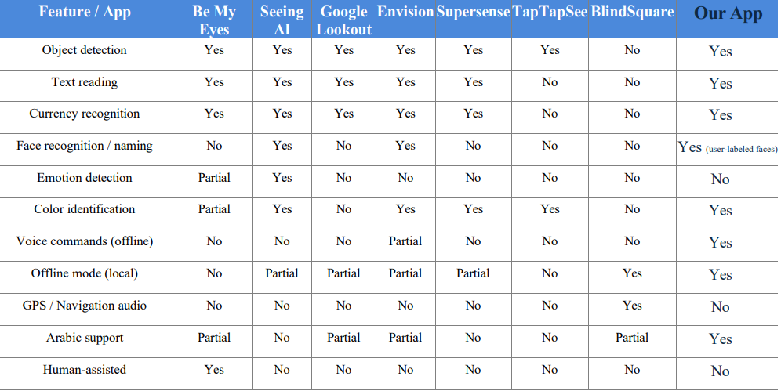
FEATURE MATRIX COMPARISON

Slide 10
FEATURE MATRIX ANALYSIS
Most popular apps cover object detection, text reading, and currency recognition.
Few apps support face recognition, color detection, offline voice commands, or Arabic language.
Existing apps often require internet, limiting privacy and usability in rural areas.
Our app stands out:
Fully offline operation
Supports face recognition with user-labeled faces
Includes color identification and voice commands
Provides Arabic language support

Slide 11
SOFTWARE DEVELOPMENT METHODOLOGY
Selected Methodology:
Iterative & Incremental Development
Justification – Why We Chose It
Modular project → 5 independent modules (Object, Currency, Color, Text, Face)
AI models need experimentation → multiple training & testing cycles
Early risk detection → identify issues (speed, accuracy, integration) quickly
Fits academic timeline → tangible progress each semester
Supports team collaboration → parallel work + GitHub branching

Slide 12
SOFTWARE DEVELOPMENT METHODOLOGY
How We Will Apply It Short iterative cycles:
Build & test Object Detection
Currency module + basic UI
Color & Text (ML Kit) integration
Voice commands
Face recognition & database
Full app integration & optimization
User testing & refinements

Slide 13
REQUIREMENTS GATHERING TOOLS
PLANNED PRIMARY METHOD:
In-person interviews: Taha Hussein Center for Blind Students (Alexandria University)
CHALLENGES FACED:
Prototype not ready yet (still in early design)
WHAT WE DID INSTEAD
Secondary data analysis:
user reviews (Google Play & App Store)
Existing studies, surveys, forums (ResearchGate, Reddit r/Blind, AFB reports)

Slide 14
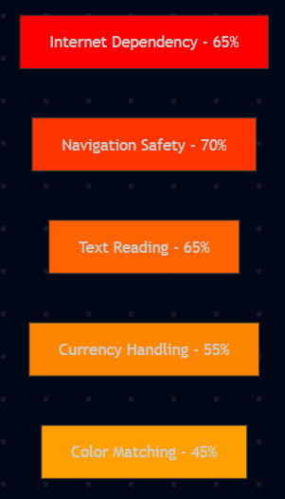
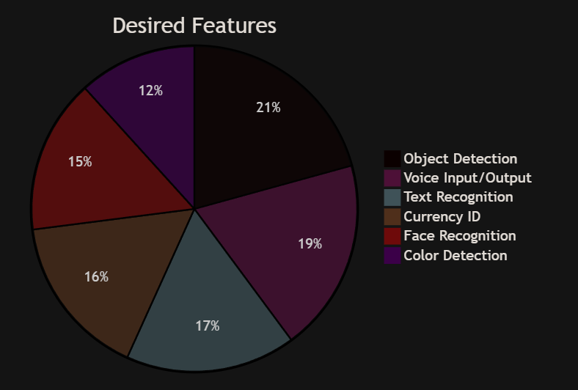
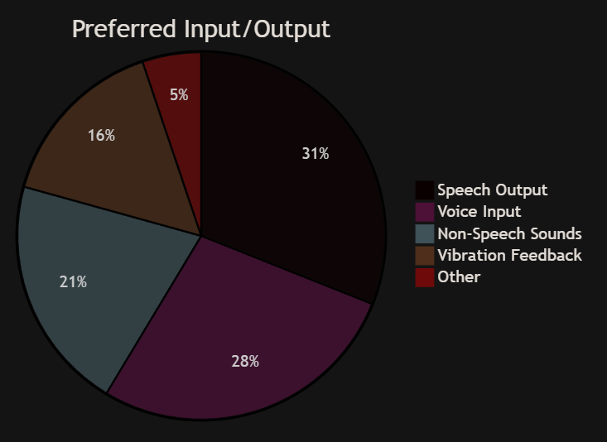
PRESENTATION OF RESULTS
Sorted by Prefrence

Slide 15
DESCUSSION OF RESULTS
From Apps Reviews:
Limited local currency support (especially Middle East/Arab users)
Want all features in one app
Limited voice commands
Multiple Languages not supported (only English)
Internet dependency (Need for offline mode)
From Online Studies & Surveys:
Top important models needed:
Text extraction
Navigation
Objects/Obstacles Detection
Color Detection
Face Detection
and most of them need App work with:
Input with Voice form
Output with Speech

Slide 16
BUSINESS REQUIREMENTS IDENTIFICATION
Overview
Build offline mobile assistant for independence & safety
Operate 100% offline (no internet needed)
Privacy-focused (all data stays on device)
Free, simple, works on basic smartphones
Extensible for future features
Stakeholders
Primary: Visually impaired users
Secondary: Caregivers, family, trainers
Project Team: Students (design, models, mobile)
Supervisors: Faculty for evaluation

Slide 17
SYSTEM FUNCTIONAL REQUIREMENTS
Main Functions:
Capture images from phone camera in real-time
Preprocess images before model inference
Run offline models (TFLite) for all detections
Convert results to clear audio messages
Support Arabic & English for voice input/output
Handle errors (low light, no detection) with voice alerts
Object Detection → YOLO11n.tflite (classes & counts)
Currency Recognition → EfficientNet.tflite (EGP notes)
Color Detection → OpenCV (dominant color)
Text Extraction → ML Kit OCR (Arabic/English)
Face Recognition → MobileFaceNet.tflite (embeddings + match)

Slide 18
SYSTEM NON-FUNCTIONAL REQUIREMENTS
Performance:
< 2 sec detection time
Low battery use
Works on mid-range phones
Security & Reliability:
Fully offline (no cloud)
Local data only (privacy)
Error handling (low light, etc.)
Usability & Accessibility:
100% voice control
Arabic & English support
Easy for non-technical users

Slide 19
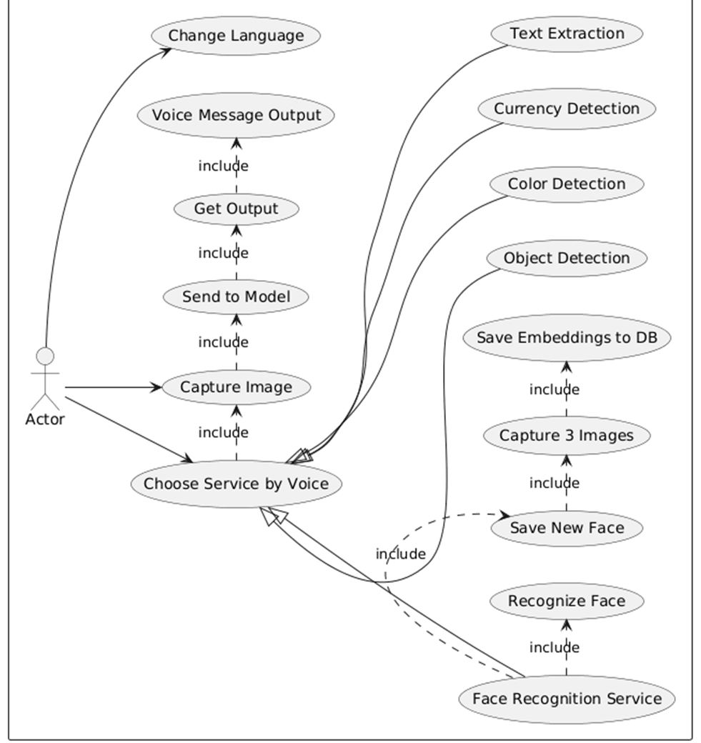
USE CASE DIAGRAM

Slide 20
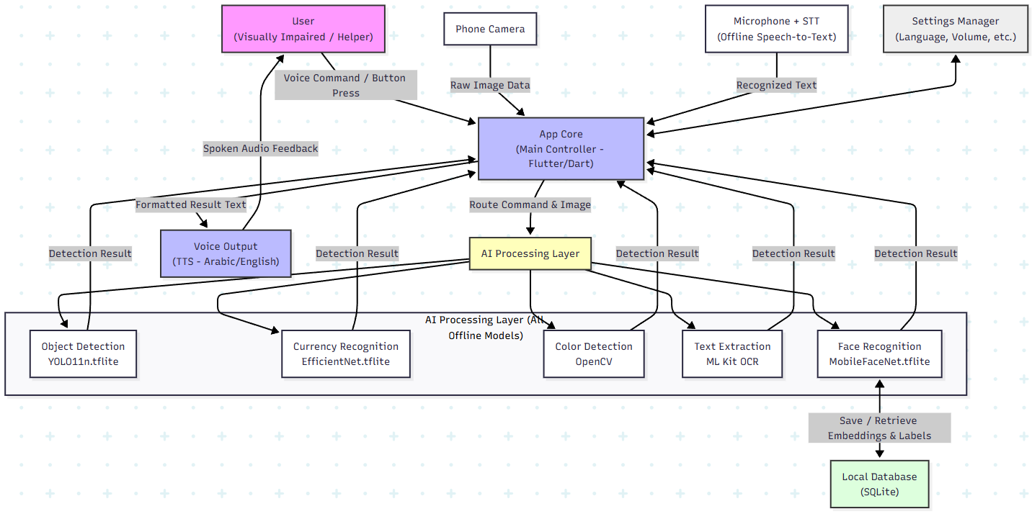
OVERALL SYSTEM ARCHITECTURE

Slide 21
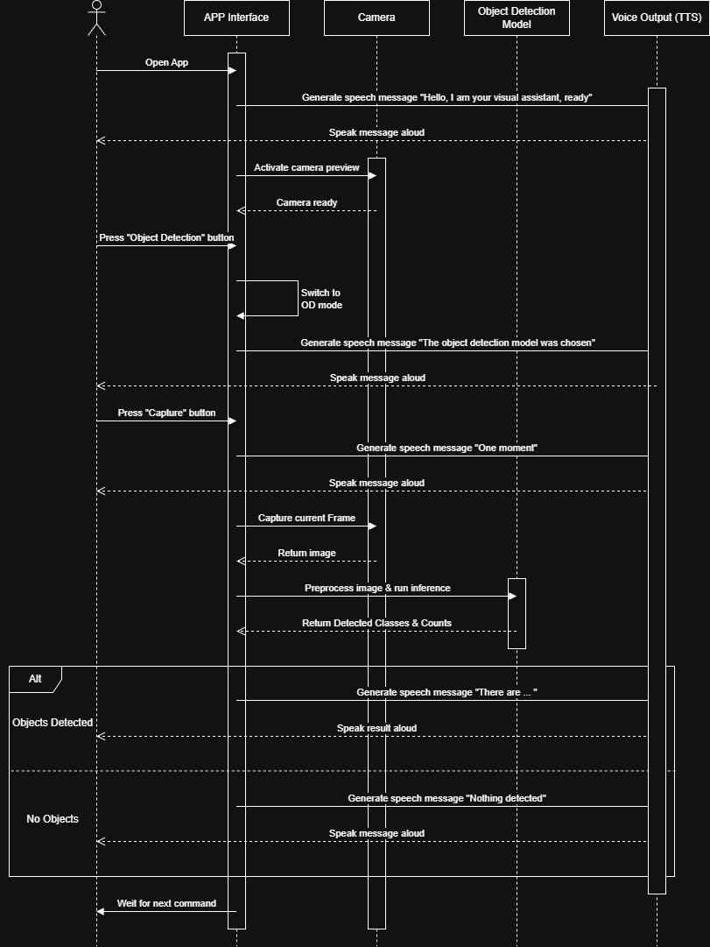
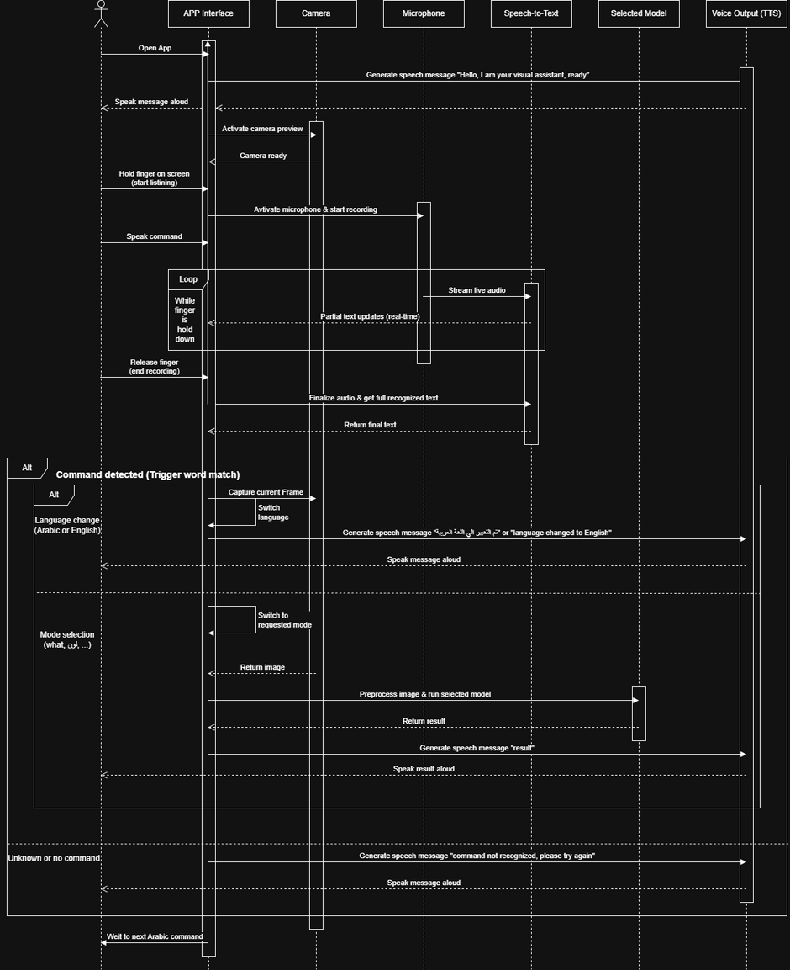
SEQUENCE DIAGRAMS
Object Detection
Voice Commands

Slide 22
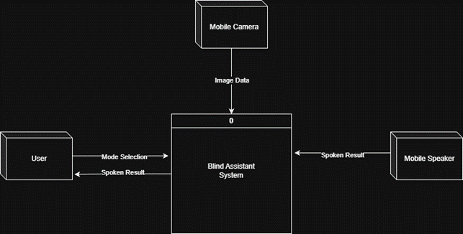
DATA FLOW DIAGRAM (DFD LEVEL 0)

Slide 23
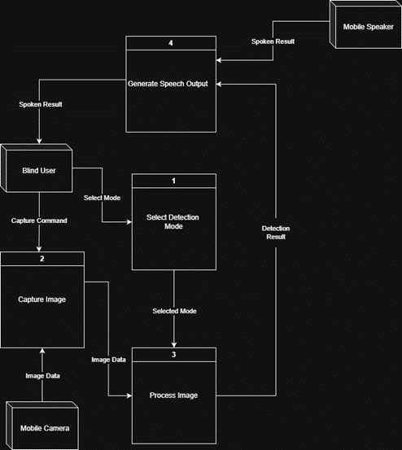
DATA FLOW DIAGRAM (DFD LEVEL 1)

Slide 24
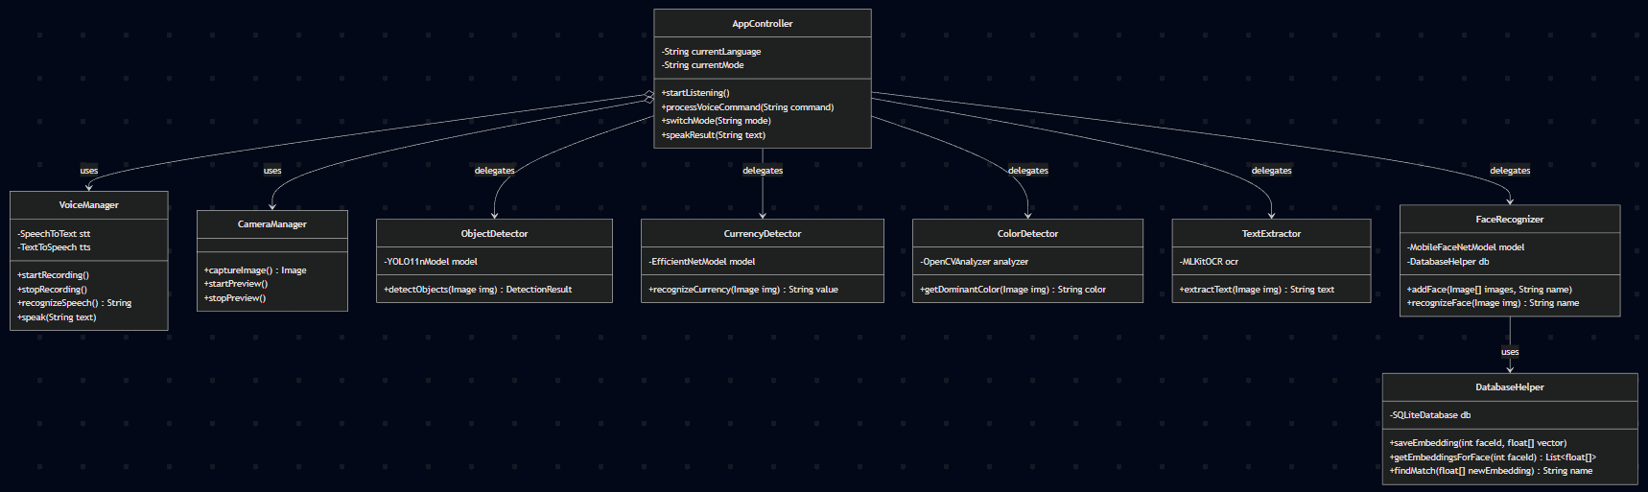
ENTITY RELATIONSHIP DIAGRAM (ERD)

Slide 25
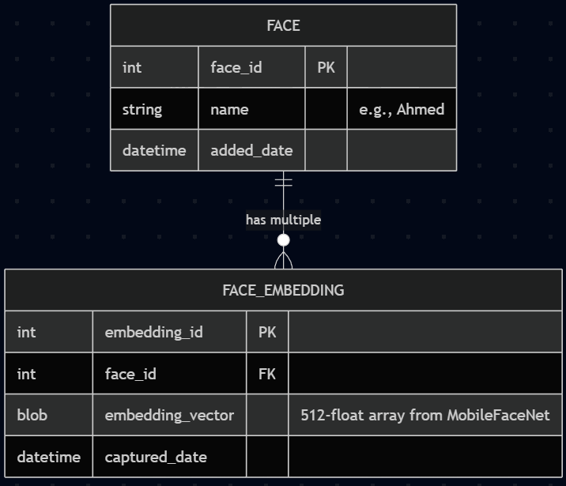
UML CLASS DIAGRAM

Slide 26
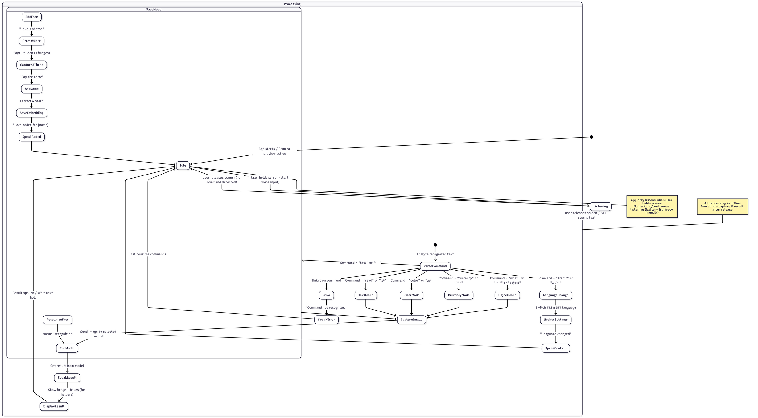
STATE DIAGRAM

Slide 27
DATASETS USED
Object Detection (YOLO11n)
Dataset: MS COCO 2017 (Train + Val)
Classes: 80 common objects
Limitation: Will add custom classes (Obstacles, stairs, curbs, etc.) in Project 2
Currency Recognition (EfficientNet)
Dataset: Custom Egyptian currency images
Classes: All Egyptian currency (5 -> 200)
Face Recognition (MobileFaceNet)
Dataset: User-generated (dynamic)
Approach: Capture 3 photos per person + label name
Stored: Local database (embeddings only)

Slide 28
DATASETS USED
Text Recognition (ML Kit OCR)
Dataset: Pre-trained (no custom training)
Support: English (current)
Limitation: Will solve and add Arabic language to support it
Color Identification (OpenCV)
Dataset: None (image processing only no training need)
Approach: Pixel analysis → dominant color

Slide 29
TOOLS AND TECHNOLOGIES
Programming Languages
Python: Model training, evaluation & conversion
Dart: Flutter mobile app development
Core Frameworks & Libraries
Flutter: Cross-platform UI (Android/iOS)
TensorFlow Lite: Offline model inference (all models converted to .tflite)
OpenCV: Color detection & image processing
ML Kit (Google): Offline OCR (text extraction – English + Arabic planned)
gTTS / Platform TTS: Voice output (Arabic/English)

Slide 30
AI MODELS INTEGRATED
Object Detection
→ YOLO11n.tflite (80 classes, lightweight, real-time)
Currency Recognition
→ EfficientNet.tflite (custom-tuned on EGP notes)
Face Recognition
→ MobileFaceNet.tflite (embeddings + cosine similarity)

Slide 31
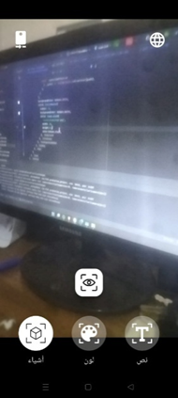
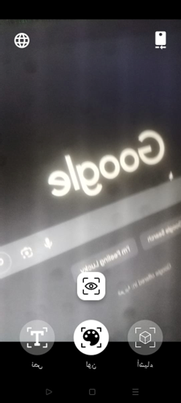
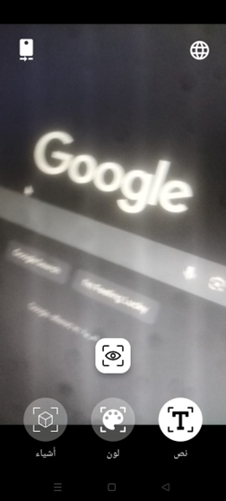
PROTOTYPE (SCREENSHOOTS)
Object Detection Screen
Color Detection Screen
Text Extraction Screen

Slide 32
AI MODEL ENHANCEMENTS
Object Detection (YOLO11n)
Extend beyond 80 COCO classes
Add user-relevant classes (obstacles, stairs, doors, traffic lights, …)
Collect custom dataset → retrain & convert to TFLite
Currency Recognition (EfficientNet)
Retrain for higher accuracy
Fix TFLite conversion issues
Test in different lighting/backgrounds
Integrate into app

Slide 33
AI MODEL ENHANCEMENTS
Text Extraction (ML Kit OCR)
Add full Arabic support
Text and try to improve accuracy
Face Recognition (MobileFaceNet)
Fix embedding storage & database issues
Improve reliability (multiple photos, unknown faces)
Color Detection (OpenCV)
Enhance to handle multiple colors & better descriptions
Improve accuracy in real-world lighting

Slide 34
APP IMPROVEMENTS
Voice Command System
Expand vocabulary (more commands)
Improve Arabic recognition accuracy
Add customization & error handling
Mobile Application Refinement
Improve voice feedback clarity & timing
Optimize performance & battery use
Test on different devices
Fix bugs & stabilize integration

Slide 35
OTHER IMPROVEMENTS
Surveys & Interviews
Visit Taha Hussein Center (late January 2026)
Show prototype to 10–20 blind students
Do structured interviews & survey
Use results to fix bugs & add features
Documentation & Final Report
Update report with testing results
Add full code explanations
Prepare final presentation & demo

Slide 36
ANTICIPATED RISKS AND SOLUTIONS
Model Performance Limitations:
Risk :
Low accuracy or slow speed on mobile
Solutions:
Test lightweight architectures
Fine Tuning, Evaluate and Optimize models
TensorFlow Lite Conversion Issues:
Risk:
Models fail to convert correctly
Solutions:
Redesign for mobile compatibility
Avoid unsupported operations

Slide 37
ANTICIPATED RISKS AND SOLUTIONS
Arabic OCR Accuracy:
Risk:
Offline Arabic text extraction may be incomplete or not accurate
Solutions:
Test multiple OCR engines
Improve image quality (preprocessing)
Face Recognition Storage & Privacy:
Risk:
Data corruption or privacy issues with embeddings
Solutions:
Use secure local storage
Add user consent & deletion options

Slide 38
ANTICIPATED RISKS AND SOLUTIONS
Voice Command Recognition Errors:
Risk :
Misinterpretation due to noise/accents
Solutions:
Add confirmation prompts
Use keyword activation (hold-to-speak)
Limited Access to Target Users:
Risk:
Difficulty reaching blind people for surveys & testing
Solutions:
Visit Taha Hussein Center and conduct survey & interview

Slide 39
CONCLUSION
What We Achieved in Project 1
Clear problem definition & strong motivation
Detailed requirements & user-centered design
Comprehensive system design (diagrams, pseudocode, architecture)
Early working prototype (voice-first, offline core)
Deep analysis of related work & tools
Project Vision
Fully offline AI vision assistant
5 core features: Object, Currency, Color, Text, Face
Voice-first, privacy-safe, Arabic-supported
Real impact: Independence & safety for visually impaired users
Looking Forward
Project 2: Full implementation, user testing, final delivery

Slide 40
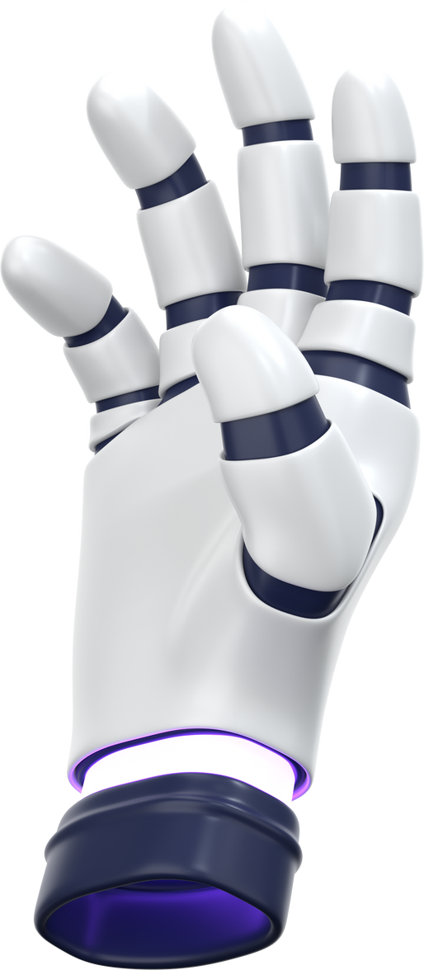
THANK YOU!
Get In Touch with Us

